Slide 1
GOOGLE AFRICA APPLIED AI LAB — APPLICATION
Swipe Right
Dating apps optimized for swipes. We optimized for the people on the other side of them.
A personality-first dating app with real safety infrastructure built in from day one — and a concrete plan to bring Gemini and African-language support into the product.
swipe-right-investors.pages.dev

Slide 2
THE PROBLEM
Swipe volume was the wrong metric all along.
Ghosting is the default outcome
Most matches never lead to a real conversation — the product never had to explain why a match happened.
Verification is an afterthought
Catfishing and fake profiles erode trust faster than growth teams can replace churned users.
Safety is a support ticket
“Report” buttons react after harm; almost no product proactively protects a first date.
02

Slide 3
THE PRODUCT
Six systems, one loop
Personality-first matching
Guardian safety layer
Blind Date Mode
Intent, deal-breakers, and a compatibility questionnaire drive an alignment score on every profile.
Scam Shield, liveness verification, Live Date Check-In, and Inner Circle contacts.
Photos stay blurred until a user chooses to reveal them — bios and prompts lead.
Pulse Sync & Shared Canvas
Verification, everywhere
Localized from day one
A post-match space with daily prompts and a joint date bucket list.
Selfie verification reviewed by a moderation queue, badge shown before chat opens.
26 languages shipped, including four African languages (below).
03

Slide 4
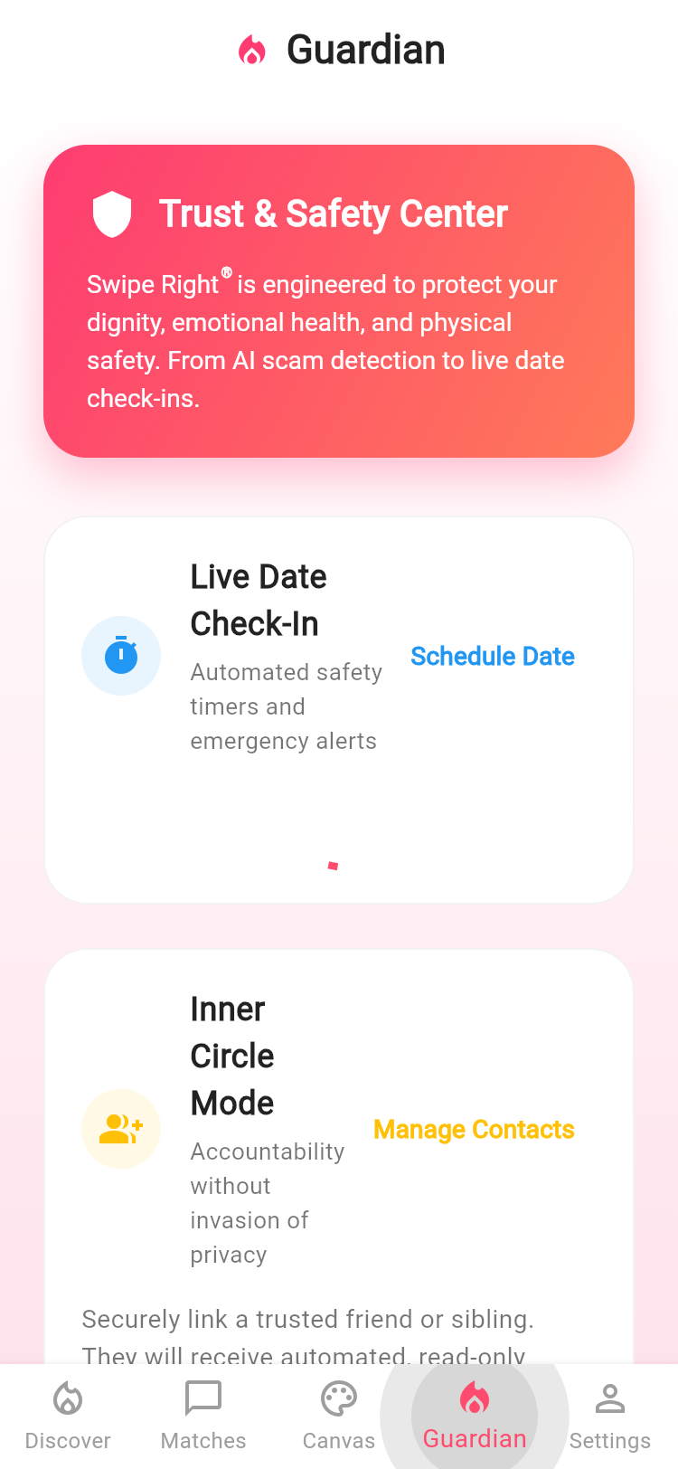
SAFETY AS PRODUCT, NOT PR
Guardian
A full Trust & Safety surface — not a single “report” button.
Before the chat
Liveness-verified badge required to message a verification-gated profile.
During the chat
Real-time detection for scam and explicit-content language patterns.
Before the date
Scheduled Live Check-In with location, time window, and an Inner Circle contact.
During the date
Automated safe-by timer alerts the Inner Circle if the user doesn’t check in.
04

Slide 5
GOOGLE AI IN THE PRODUCT
Gemini writes the first message — grounded in what your match actually said.
AI ICEBREAKER COACH — SHIPPED, POWERED BY GEMINI 2.0 FLASH
Grounded, not generic
The prompt sends both users’ actual profile prompt answers to Gemini — no template openers, no hallucinated context.
models/gemini-2.0-flash
:generateContent
systemInstruction:
“Write warm, natural
icebreakers grounded in
the match’s prompts.”
returns → openerText,
referencedPromptId
Cloud Function, callable client
generateIcebreakerSuggestions runs on Firebase Cloud Functions and calls the Generative Language API directly.
Fails honestly
If the model isn’t configured, the app falls back to a local rule-based suggester instead of pretending AI ran.
This is the first Gemini integration — the Lab’s early model access is what lets us extend the same grounded approach into Guardian’s Scam Shield and richer compatibility explanations next.
05

Slide 6
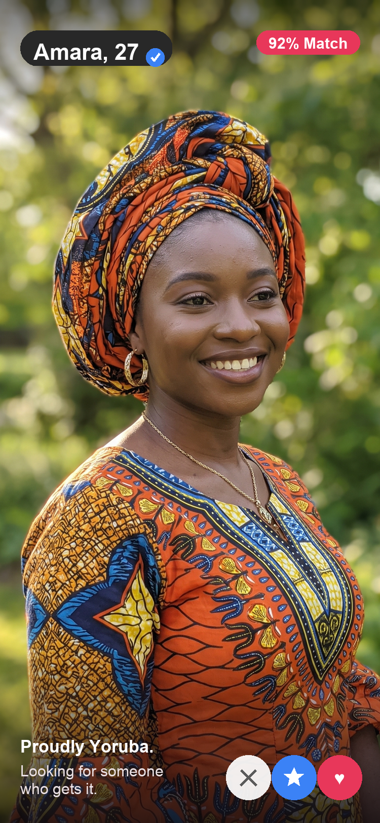
WHY AN AFRICAN-FIRST DATING APP
Family, faith, and intention aren’t edge cases to design around.
Most dating apps were built for a culture where two people decide alone. Across much of Africa, a match is read against family expectations, faith, and a shared sense of what “serious” means. We think that’s the thing to design for, not strip away.
Intent first
Relationship intent — marriage, serious, casual — is a first-class onboarding field, not a buried filter.
Trust over volume
Guardian’s Inner Circle, liveness verification, and Live Date Check-In are the digital version of a relative walking you to the door.
Spoken in your language
A courtship conversation forced into someone’s second language already asks them to leave part of themselves out.
06

Slide 7
LOCALIZATION, SHIPPED
Localization is where we start — not where we stop.
Swipe Right ships real African-language translations today, and the Lab’s go-to-market support is what turns that into an actual African launch plan — not just a language picker entry.
Kiswahili
Yorùbá
አማርኛ
isiZulu
KENYA · TANZANIA
NIGERIA
ETHIOPIA
SOUTH AFRICA
Shipped this cycle, alongside 22 other languages — 26 total, all reachable from the in-app language picker.
WHAT WE’D BUILD IN THE PROGRAM
Full-app translation coverage for all four languages, a safety-messaging pass reviewed by local partners, and a demo-day showcase of Gemini-grounded matching tuned on African-market usage patterns.
07

Slide 8
THE PRODUCT, LIVE
Freemium, with three ways to go deeper
SR Gold
See who likes you
New curated top picks daily
5 Super Likes a week
SR Platinum
Priority placement on likes sent
Message before they swipe back
Everything in Gold
SR Plus
Unlimited likes
Unlimited rewinds
Ad-free browsing
08

Slide 9
UNDER THE HOOD
One codebase, every platform — plus Google’s AI at the edge.
Flutter
Firebase Auth
Cloud Firestore
iOS, Android, and web from a single codebase
Account identity and session management
Profiles, matches, messages, Guardian state
Cloud Storage
Cloud Functions
Gemini 2.0 Flash
Photos and verification selfies
Server-side moderation, deletion, safety logic
Grounded icebreaker generation (Generative Language API)
09

Slide 10
WHAT WE’RE LOOKING FOR
Model access and go-to-market muscle — not just capital.
Early access to Gemini & DeepMind models
To extend the grounded-generation approach already shipping in the Icebreaker Coach into Guardian’s Scam Shield and compatibility explanations.
Technical mentorship from Google Research
On production patterns for safety-critical AI — explainability, false-positive rates, and abuse resistance.
Go-to-market support for African markets
Turning four shipped languages into a real regional launch, with VC introductions through the Lab’s partner network.
10

Slide 11
Swipe Right
Let’s build the AI-native generation of Africa’s dating category — together.
rdgabmomoh@gmail.com
swipe-right-investors.pages.dev
11

